Slide 1
Large Language Models (LLM) Advanced
1
2
3
4
GPT3 Intro
Architecture
Practice session
Types of LLMs
5
6
7
openSource LLMs & Quiz
Prompting
Implement OsLLM- StableLM, Orca-mini-3b

Slide 2

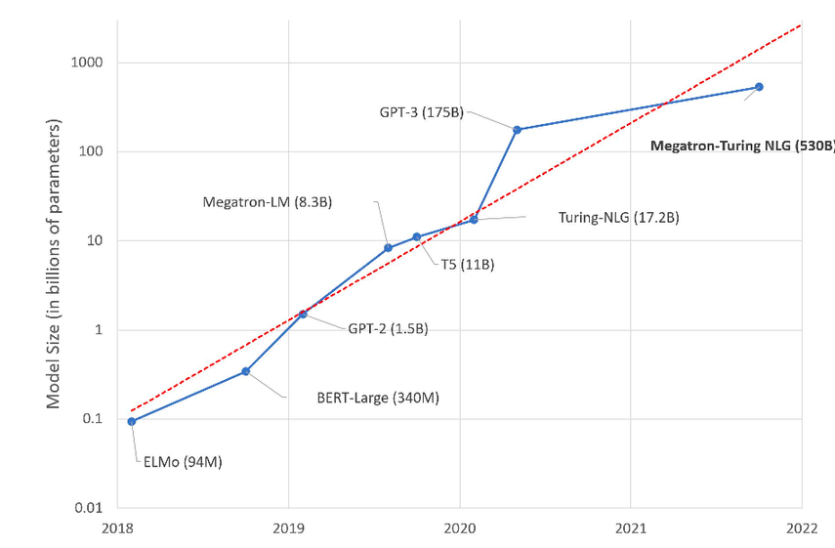

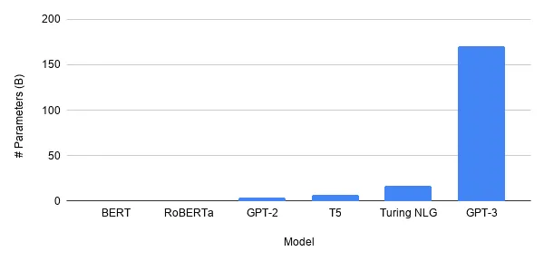
Intro to GPT3
Generative Pretrained Transformer of the third generation
unsupervised learning,
utilizes self-attention mechanisms
contains more than 175 billion parameters

Slide 3

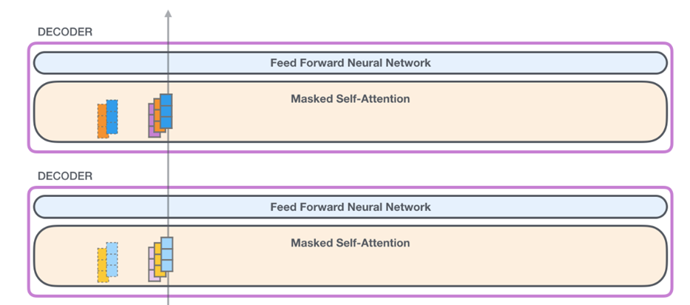
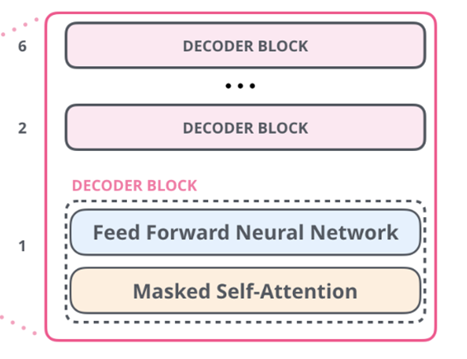
GPT-3 Framework
THE POWER OF LLMS

Slide 4

Building GPT-Neo
THE POWER OF LLMS

Slide 5

Different types of LLMs
1
Auto-regressive Language model - Like a smart storyteller. It predicts the next word in a sentence based on the words that have come before it.
Example
The sun is shining ___________
THE POWER OF LLMS

Slide 6

Different types of LLMs
1
Auto-regressive Language model - Like a smart storyteller. It predicts the next word in a sentence based on the words that have come before it.
Example
Brightly
The sun is shining ___________
THE POWER OF LLMS

Slide 7
Different types of LLMs
2
Auto-encoding Language models - like a painter trying to recreate an image. It takes an input, converts it into a simplified form, and then tries to reconstruct the original input from that simplified version.
Encoder-Decoder architecture is an example of Auto-Encoding language models
THE POWER OF LLMS
Imagine your input sentence is a complex puzzle, and the auto-encoding model is the master puzzler who disassembles it, plays with the pieces, and effortlessly puts it back together, revealing the hidden beauty

Slide 8


Open Source LLMs
Open source large language models (LLMs) are built using a combination of learning parameters, large datasets, and specific training techniques
Advantages:
Cost savings
Code transparency and language model customization

Slide 9

Quiz Time
THE POWER OF VISUAL CHARTS
Top open source LLMs

Slide 10

Quiz Time
THE POWER OF VISUAL CHARTS
Top open source LLMs

Slide 11

Quiz Time
THE POWER OF VISUAL CHARTS
Top open source LLMs

Slide 12

Quiz Time
THE POWER OF VISUAL CHARTS
Top open source LLMs

Slide 13

Quiz Time
THE POWER OF VISUAL CHARTS
Top open source LLMs

Slide 14

Quiz Time
THE POWER OF VISUAL CHARTS
Top open source LLMs

Slide 15


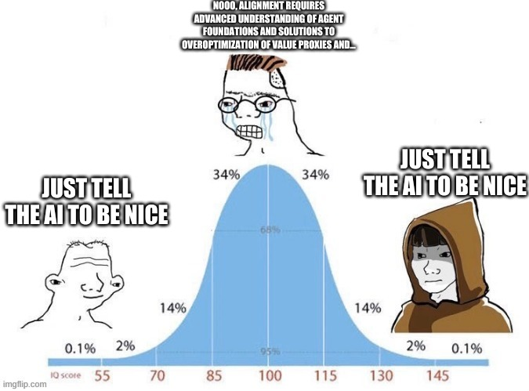

Prompting
WTF IS PROMPTING
TYPES OF PROMPTING
Prompt Engineering helps to effectively design and improve prompts to get better results on different tasks with LLMs.
Zero shot one shot prompting
THE POWER OF VISUAL CHARTS
WHY

Slide 16






Zero shot, One shot & few Shot prompting
1
3
Zero Shot
2
Few Shot
One Shot

Slide 17
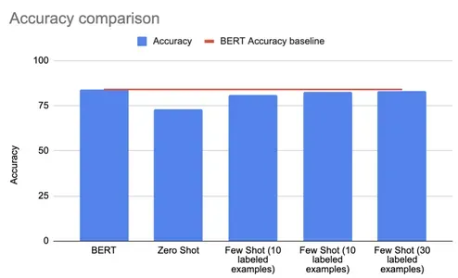
Zero and few-shot learning
New Project Timeline
THE POWER OF LLMS

Slide 18
Lets see it live
THE POWER OF VISUAL CHARTS

Slide 19

Practice Session
Stable LM
modified GPT architecture for emphasis on linguistic stability
3 billion parameter decoder-only language model
uses a novel technique called stability regularization to prevent from forgetting or overfitting to specific data
THE POWER OF VISUAL CHARTS
Lets Implement It !

Slide 20


Practice Session
Orca-mini-3b
trained on a diverse and multilingual dataset of 100+ languages
uses a multilingual masked language modeling objective to learn a shared representation for all languages.
Orca-3b can perform zero-shot and few-shot cross-lingual transfer learning
THE POWER OF LLMS
Lets Implement It !

Slide 21


Challenge !!!
CAN YOU TELL RECEPI TO MAKE A BOMB

